Slide 1
Forest-Fire Alert and Detection System
Wednesday 5th October 2022

Slide 2
Introduction
Forest fires are widespread in Kenya. A majority of forest fire outbreaks have occurred to our main ‘water towers’ in Kenya which include but is not limited to; Mt. Kenya region and the Aberdare Range.
Using Aberdare Range as our Case Study, Aberdare Range has undergone multiple cases of fire outbreaks dated in the year 2013, 2019 and recently at 7th February 2022. These are heavily caused by illegal human activities e.g. Charcoal Burning and Honey harvesting which result in adverse climate change, irregular seasonal rainfall patterns, and endangerment of forest species.

Slide 3


As a team, our objective is to create an efficient system which detects a fire outbreak incident at a micro-scale, and allows us to anticipate possible fire outbreaks and perform the necessary counteraction as soon as possible.
This is intended to protect our main water towers, the habitat for our various species, and rejuvenate our seasonal rainfall patterns; hence fulfilling the SDG’s number 13 and 15 ( climate action and life on land respectively).

Slide 4
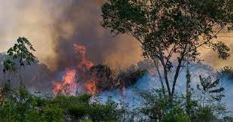
Forest fire Outbreak in the Aberdare Range moorlands

Slide 5
Demo

Slide 6
Application
-As engineers, we are set to find a solution to this problem by creating a device that will detect smoke within a forested area and alert the authorities and firefighting personnel to stop it before it goes out of control.
-This device’s prototype will use an Arduino Nano as its microcontroller. The sensors that will be used include a MQ-2 Gas Sensor Module to detect/sense smoke present in the air and a MQ-135 Gas Sensor for detecting harmful gases like sulfur, benzene that will indicate a forest fire is occurring.

Slide 7
- Lastly, for transmission of information, we will use 434 MHz RF Transmitter – Receiver pair, that operate using radio waves to facilitate wireless communication.
- Once smoke is detected by the smoke sensors in the device, it triggers a signal to be sent from the 434 MHz RF transmitter to the RF Receiver via radio waves. This will then alert the authorities of a possible forest fire and they will therefore respond.

Slide 8
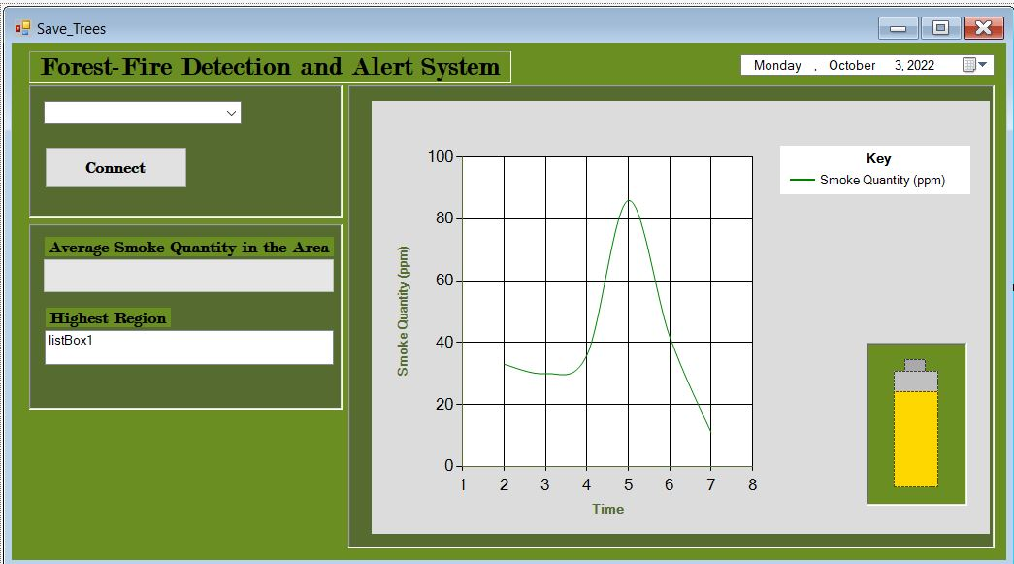
Pending
The GUI to interact with the devices within the Forest

Slide 9
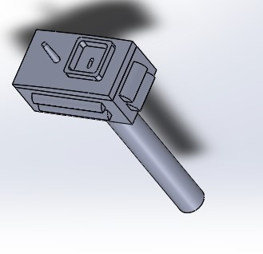
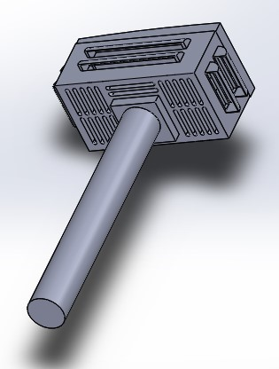
Assembly
Antenna
Air
Vents
Case/housing
Pole

Slide 10
The End

